Slide 1

Customer Segmentation and RFM Strategies

Slide 2

Customer Segmentation
Customer segmentation is like sorting your customers into different groups based on things like age, how often they shop, what they like to buy, or where they live.
This helps businesses understand their customers better and offer products or services that match what each group likes.
It's like personalizing your approach to each group, which makes customers happier, keeps them coming back, and boosts sales.

Slide 3
RFM (Recency , Frequency, Monetary)
Recency (R) shows how long it's been since a customer bought something, telling us how active they are.
Frequency (F) tells us how often a customer buys from us, showing how loyal they are.
Monetary Value (M) is about how much a customer spends, helping us see how valuable they are to our business.

Slide 4
Why RFM Analysis?
Simple Segmentation
Identify Valuable Customers
Personalized Marketing
Improve ROI
Strategic Decision Making

Slide 5
RFM Analysis Process
Data Collection: Gather customer transaction data
RFM Calculation: Calculate Recency, Frequency, and Monetary values for each customer based on their transaction history.
RFM Segmentation: Segment customers into RFM groups (e.g., Champion, Loyal, Potential Loyalist) using predefined criteria or percentiles.
Analysis and Insights: Analyze each RFM segment's characteristics, behavior, and value to the business.

Slide 6
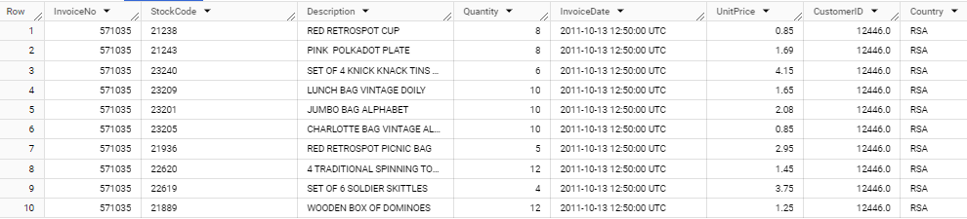
Overview

Slide 7
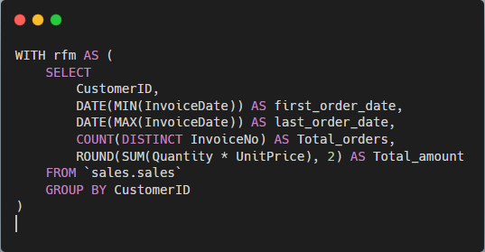
Creating RFM Metrics
This part of the query calculates RFM metrics for each customer in the dataset.
First_order_date: The earliest order date for each customer
Last_order_date: The latest order date for each customer
Total_orders: The total number of orders placed by each customer
Total_amount: The total monetary amount spend by each customer

Slide 8
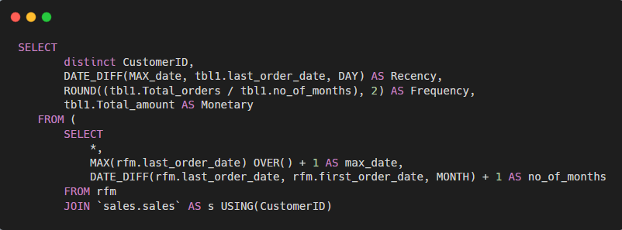
Calculating Recency, Frequency, and Monetary (RFM) Metrics:
Recency: Calculates the number of days between the last order date and the maximum order date in the dataset
Frequency: Calculates the average number of order per month by dividing ‘Total_order’ by the number of months between the first and last order dates
Monetary: Represents the total amount spent by each customer

Slide 9
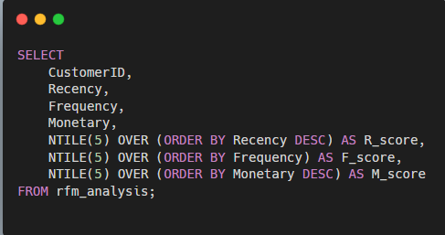
Creating RFM Scores
NTILE(5): Divides the customer into 5 equal-sized groups(quintile) based on their Recency, Frequency, Monetary Values
Order by: Specifies the ordering of customer within each quintile, such as recency in desc order (putting the most recent customers at the top of the list).

Slide 10
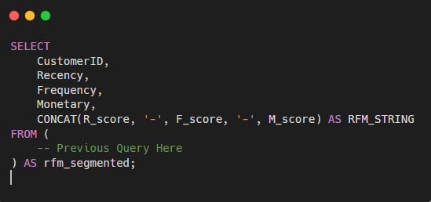
Concatenating RFM Scores
This part of the query concatenates the individual RFM scores (R_score, F_score, M_score) into a single string format (RFM_STRING).
CONCAT: combines the scores with hyphens (-) as separators to create the RFM_STRING.

Slide 11
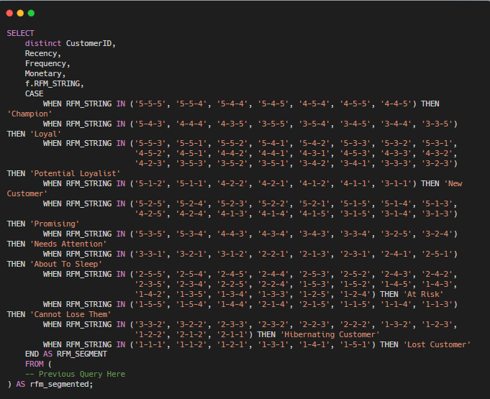
Assigning RFM Segments
This final part of the query assigns RFM segments to customers based on their RFM_STRING.
The CASE statement checks the RFM_STRING values and assigns corresponding segment names ('Champion', 'Loyal', etc.).
You can add more WHEN conditions for other RFM segments as needed.
The ELSE part specifies a default segment ('Other Segment') for RFM_STRING values that do not match any specified conditions.

Slide 12
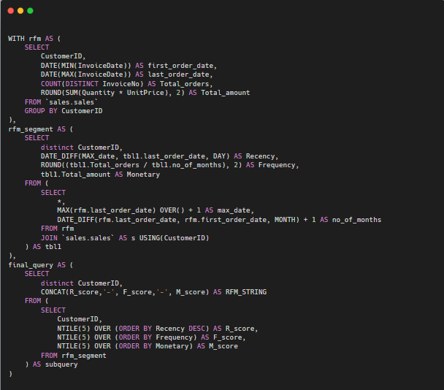
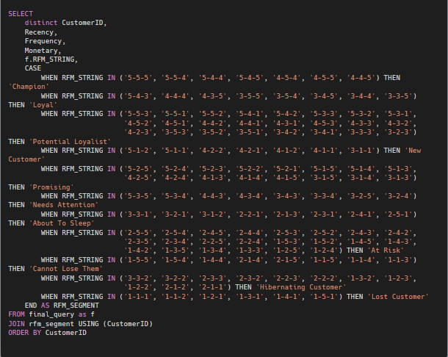
Comprehensive SQL Query for RFM Segmentation and Customer Analysis

Slide 13

Strategic Insights from RFM Analysis
Customer Engagement Trends
Active and engaged customers are often categorized as "Champion" or "Loyal," with higher Recency and Frequency scores.
Revenue Contribution
RFM Monetary values help identify segments contributing the most revenue, guiding strategies for retaining high-value customers.
Identifying New Opportunities
Growth opportunities lie within the "New Customer" segment, which can be nurtured into loyal and high-value customers.
Risk Mitigation
Proactive measures for "At Risk" and "Lost Customers" segments to mitigate churn and improve retention rates.

Slide 14
CONCLUSION
In conclusion, RFM analysis has been instrumental in uncovering valuable insights about our customer base.
By evaluating Recency, Frequency, and Monetary aspects, we've identified distinct customer segments and their purchasing behaviors.
This knowledge equips us to tailor marketing strategies, improve customer retention, target high-potential segments, and make data-driven decisions for business growth.
As we continue leveraging RFM analysis, we aim to deepen customer relationships, enhance satisfaction, and drive sustainable success in our market.

